Slide 1
Introduction to Big Data
Lesson 22.1
‹#›

Slide 3
Class Objectives
By the end of this lesson, you will be able to:
Identify the parts of the Hadoop ecosystem.
Write a Python script that implements the MapReduce programming model.
Identify the differences between the Hadoop and Spark environments.
Create a DataFrame by using PySpark.
Filter and order a DataFrame by using Spark.

Slide 4
Intro to Big Data

Slide 5
Intro to Big Data

Slide 6
Big data refers to a large amount of structured, unstructured, or semistructured data that’s received at a fast rate, that’s received with the utmost accuracy, and that needs to be processed at a high capacity.

Slide 7
Large datasets have been on the rise since the inception of the internet. But, what’s a large dataset? And, just how big is big data?

Slide 8
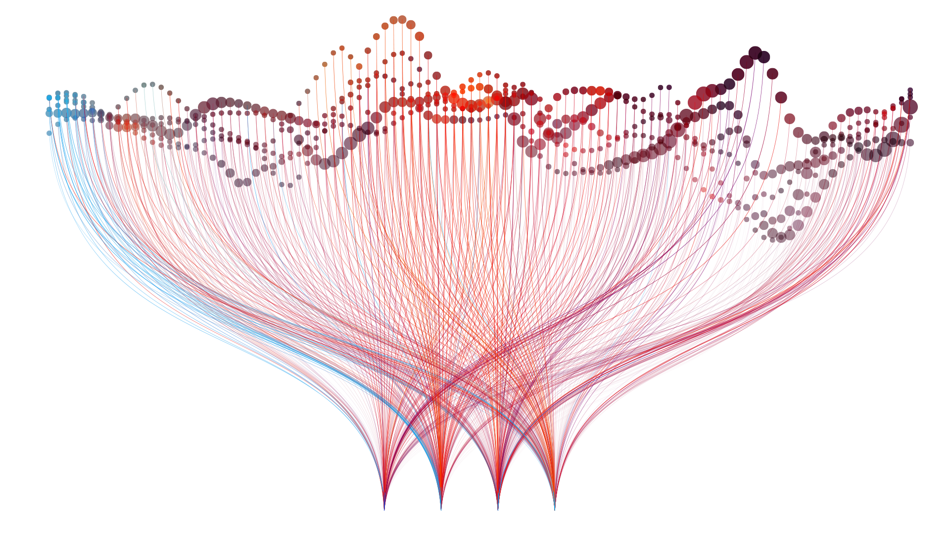
Big Data: History
In the late 1990s, the term “big data” referred to any information that filled more than a gigabyte. Today, big data can range from hundreds of gigabytes to exabytes of data.

Slide 9

How Big Is Big Data?
To give us an idea of just how big these amounts are, the following table lists data sizes along with an example of what each size might contain:
Size | Example
One kilobyte (KB) | A paragraph in a text document
One megabyte (MB) | A small novel
One gigabyte (GB) | Either about 10,000 rows in a CSV file or one low-definition streamed movie
One terabyte (TB) | About 500 hours worth of videos on the internet
One petabyte (PB) | About 11,000 high-definition movies
One exabyte (EB) | About 11 million high definition movies
has about 100 petabytes worth of stored videos across the world.

Slide 10
Generally, we consider a dataset to be big data if it’s too large for an operational database.

Slide 11
An operational database allows users to modify, retrieve, and manage data in real time.

Slide 12
The Four Vs of Big Data
Volume: The size of the data.
Velocity: The rate at which the data is received.
Variety: The diversity of the data: structured, unstructured, or semistructured.
Veracity: The uncertainty of the data. That is, how accurate is the data? Does it include errors, abnormalities, or biases?

Slide 13

Hadoop is an open-source framework for big data. It consists of several components.

Slide 14
Hadoop Distributed File System
The Hadoop Distributed File System (HDFS) enables the efficient and cheap storage of large quantities of data across multiple servers while minimizing the risk of data loss.
NameNode
Metadata
Metadata Ops
Client
Block Ops
DataNodes
DataNodes
Read
Replication
Rack 1
Rack 2
Client

Slide 15

Hive is a SQL-like query tool for big data.

Slide 16
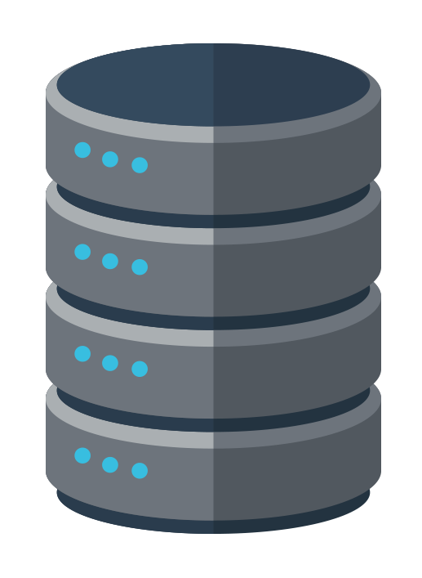
Hive Architecture
JDBC/ODBC
CLI
Hive Thrift Server
Hive Web Interface
Driver
Parser
Planner
MSClient
Metastore
Execution
Optimizer
MapReduce
HDFS
RDBMS

Slide 17
MapReduce simultaneously processes vast amounts of multi-terabyte datasets in large clusters, or on multiple servers, in a fault-tolerant manner.

Slide 19
MapReduce with MRJob

Slide 20
MapReduce with MRJob

Slide 21
MapReduce with MRJob (1 of 3)
Google created MapReduce with the initial purpose of indexing all the information on the internet. Now, people use MapReduce as a way to distribute and process the data in a cluster. Basically, a MapReduce job divides the input data into chunks, which the map tasks process in a parallel manner.
Input
Splitting
Mapping
Shuffling
Reducing
Final Result
Deer Bear River
Deer Bear River
Deer Bear River
Bear (1,1)
Bear, 2
Bear, 2
Car Car River
Car Car River
Car Car River
Car (1,1,1)
Car, 3
Car, 3
Deer Car River
Deer Car Bear
Deer Car Bear
Deer (1,1)
Deer, 2
Deer, 2
River (1,1)
River, 2
River, 2

Slide 22
MapReduce with MRJob (2 of 3)
Mapping means splitting up data, preprocessing it, and then converting it into key-value pairs.
Input
Splitting
Mapping
Shuffling
Reducing
Final Result
Deer Bear River
Deer Bear River
Deer Bear River
Bear (1,1)
Bear, 2
Bear, 2
Car Car River
Car Car River
Car Car River
Car (1,1,1)
Car, 3
Car, 3
Deer Car River
Deer Car Bear
Deer Car Bear
Deer (1,1)
Deer, 2
Deer, 2
River (1,1)
River, 2
River, 2

Slide 23
MapReduce with MRJob (3 of 3)
Reducing means aggregating the results.
Input
Splitting
Mapping
Shuffling
Reducing
Final Result
Deer Bear River
Deer Bear River
Deer Bear River
Bear (1,1)
Bear, 2
Bear, 2
Car Car River
Car Car River
Car Car River
Car (1,1,1)
Car, 3
Car, 3
Deer Car River
Deer Car Bear
Deer Car Bear
Deer (1,1)
Deer, 2
Deer, 2
River (1,1)
River, 2
River, 2

Slide 24
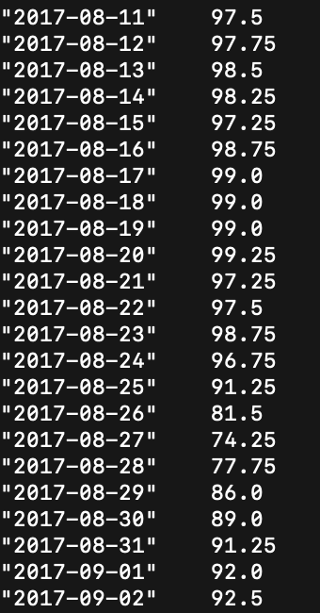
MapReduce: An Example Use Case
Imagine that our organization collects temperature data every day of the year for a city in the United States.
We can use MapReduce to find many aggregations.
But, one example is the average maximum temperature for each day over all the days in the dataset.
climate.gov

Slide 26
Activity: MapReduce Use Cases
In this activity, you’ll find common use cases for MapReduce. The ability to research and learn about common use cases is an important skill to have in your career.
10 minutes

Slide 29
MRJob with Python

Slide 30
MapReduce is intended to distribute and process large data files.

Slide 31
MRJob is a Python package that we can use to locally test our MapReduce code on our own computers.

Slide 32
15 Minutes
MRJob with a CSV File
In this activity, you’ll use MRJob with a CSV file to count the number of hot days in Austin, Texas.

Slide 34
Activity: Snow in Austin
In this activity, you’ll use MRJob to return the days when it snowed in Austin, Texas.
15 minutes

Slide 38
Spark Overview and
Spark Installation Check

Slide 39
Spark Overview

Slide 40

Spark: The Beginning
MapReduce was an amazing leap forward for handling massive amounts of data, but it was still slow.
So, the AMPLab at UC Berkeley came up with the idea of storing data in Resilient Distributed Datasets (RDDs) and using memory instead of disk space.
That improved the speed by 100 times.

Slide 41
Although AMPLab developed Spark, they later donated it to the Apache Software Foundation—which now maintains it.
That’s why you might find it called Apache Spark, just like you might find Hadoop called Apache Hadoop.

Slide 42

Spark: The Evolution
As Spark evolved to its current version, 3.x, the direct use of RDDs was simplified by the use of datasets and DataFrames.
JDBC
Console
User Programs
(Scala, Python, Java, R, and SQL)
Spark SQL
DataFrame API
Catalyst Optimizer
Spark
RDDs

Slide 43
Spark: Supported Languages and More
Spark can be programmed in Scala, Python, Java, R, and SQL.
It has a rich ecosystem and is very scalable.
JDBC
Console
User Programs
(Scala, Python, Java, R, and SQL)
Spark SQL
DataFrame API
Catalyst Optimizer
Spark
RDDs

Slide 44
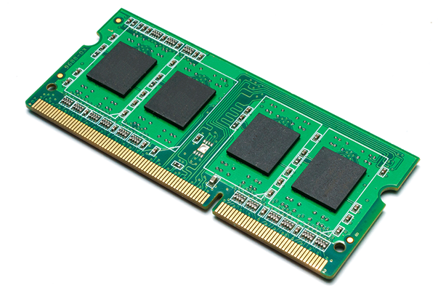
Spark: In-Memory Computation
Spark uses in-memory computation instead of a disk-based solution. That means it has a limited need to read or write data from disks.
Iterative:
Iteration 2
Iteration 1
Input
Interactive:
Query 1
Select
Input
Query 2

Slide 46
10 Minutes
Spark Installation Check
In this activity, you’ll check to make sure you have installed your dependencies to run PySpark in Jupyter notebook.

Slide 48
PySpark DataFrame Basics

Slide 49
PySpark DataFrame Basics

Slide 51
Activity: Demographic DataFrame Basics
In this activity, you’ll use PySpark DataFrame basics to analyze demographic data.
20 minutes

Slide 54
PySpark Filtering

Slide 55
PySpark Demographic Filtering

Slide 57
Activity: PySpark Demographic Filtering
In this activity, you’ll use the PySpark filtering functions to filter through the demographic dataset.
15 minutes

Slide 60
‹#›

